Slide 1
Visualization Basics
Readings: Chap 2

Slide 2
Review
What is the purpose of visualization?
How do we accomplish that?

Slide 3
Graphic representation shall seek a maximum reduction of confusion
  For a certain domain and during a certain time
  All the participants come to agree on certain meanings expressed by certain representation
  And agree to discuss them no more
Evolution of visualization
…passes from the “dead image”, the “illustration”, to the living image, the widely accessible research instrument it is now becoming (Bertin)

Slide 4
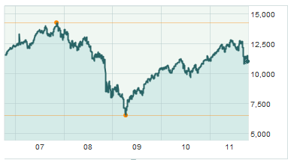
Visualization is used to
  Record information (a storage mechanism)
    Photographs, blueprints
  Communicate information (convey to others)
    Share and persuade, collaborate and review, emphasize important aspect of data
  Process information (a research instrument)
    Process, reason, interact, feedback
Separate the content and the container
You can find the index value at a given time (storage)
You can tell the trends of the stock market in a certain period of time (research)
Financial crisis
Recovery
The Dow Jones Industry Average in the past five years

Slide 5
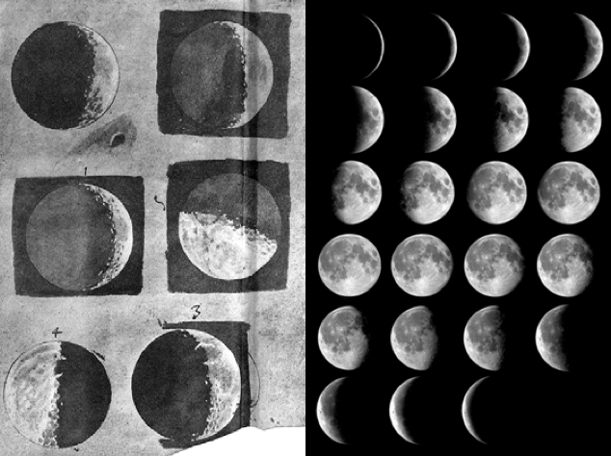
Record information
  Record information (a storage mechanism)
    Photographs, blueprints

Slide 6
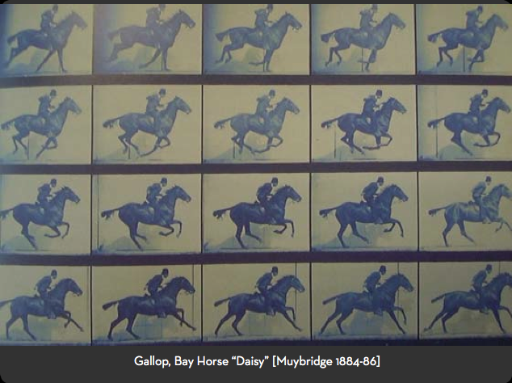
Record information
  Record information (a storage mechanism)
    Photographs, blueprints

Slide 7
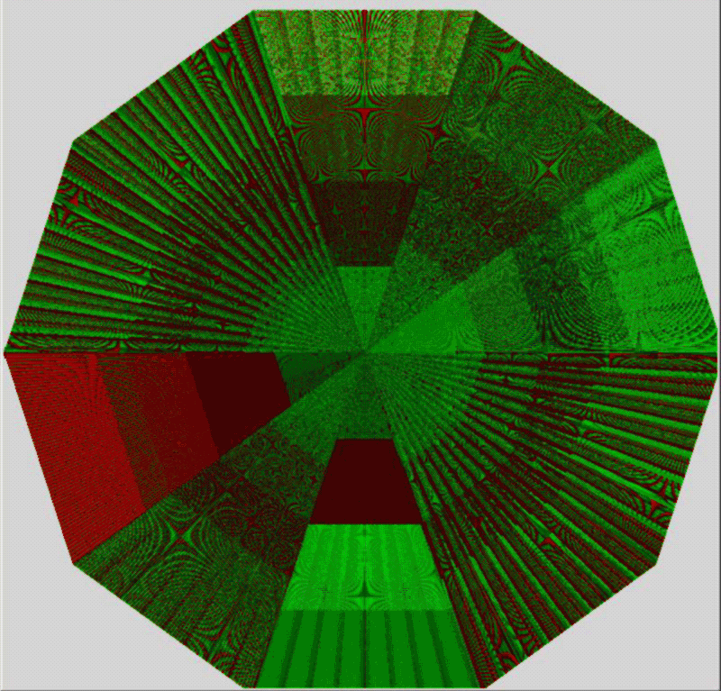
Process information
PolarEyes

Slide 8
Challenge
2010: 1200 exabytes of data
10x increase over 5 years
Gantz et al 2008, 2010

Slide 9
Basic Visualization Model

Slide 10
Goal
Data
Data transfer
Insight
(learning, knowledge extraction)

Slide 11
Method
Data
Data transfer
Insight
Map:
data → visual
~Map⁻¹:
visual → data insight
Visualization
Visual transfer
(communication bandwidth)

Slide 12
Visual Mappings
Data
Visual Mappings must be:
Computable (math)
  visual = f(data)
Comprehensible (invertible)
  data = f⁻¹(visual)
Creative!
Map:
data → visual
Visualization

Slide 13
Visualization Pipeline
task
Raw data
(information)
Data
tables
Visual
structures
Visualization
(views)
Data
transformations
Visual
mappings
View
transformations
User interaction

Slide 14
Components – visual variables
Three stages in the graphical analysis of Information
  Determine the NUMBER OF COMPONENTS
  Identify the LENGTH (number of elements or categories) of a given COMPONENT or VARIABLE
  Determine the LEVEL OF ORGANIZATION
    The qualitative level
    The ordered level
    The quantitative level

Slide 15
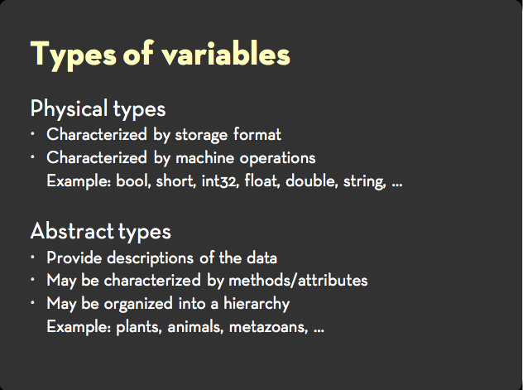

Slide 16
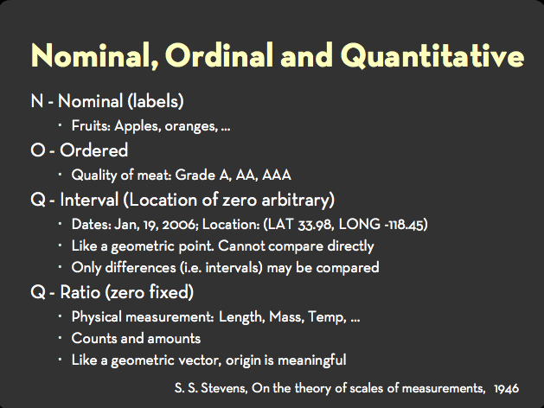

Slide 17
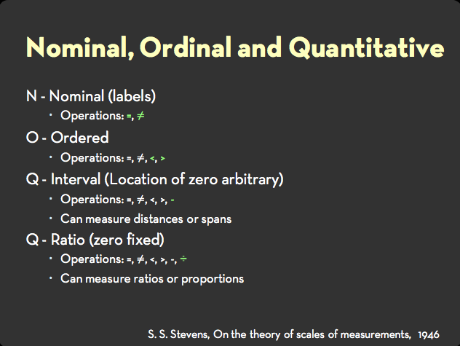

Slide 18
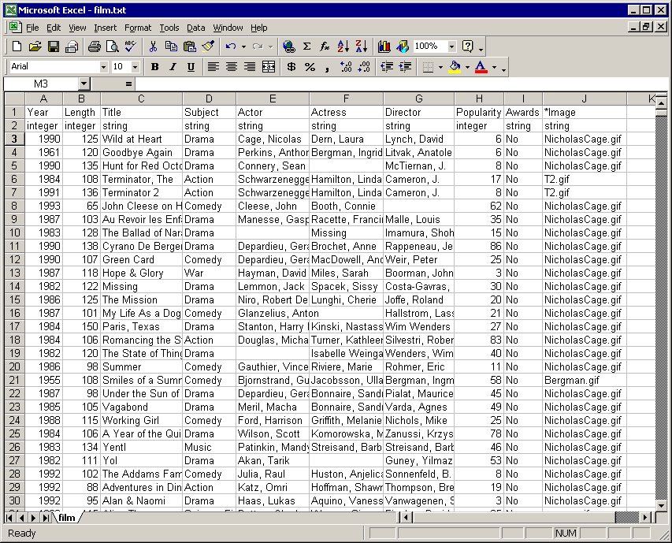
Data Table: Canonical data model
Visualization requires structure, data model
(All?) information can be modeled as data tables

Slide 19
Data Table
Attributes (aka: dimensions, variables, fields, columns, …)
Values
Data Types:
Quantitative
Ordinal
Categorical
Nominal
Items
(aka:
tuples, cases, records,
data points, rows, …)

Slide 20
Attributes
Dependent variables (measured)
Independent variables (controlled)
ID | Year | Length | Title
0 | 1986 | 128 | Terminator
1 | 1993 | 120 | T2
2 | 2003 | 142 | T3
… | … | … | …

Slide 21
Data Transformations
Data table operations:
    Selection
    Projection
    Aggregation
      r = f(rows)
      c = f(cols)
    Join
    Transpose
    Sort
    …

Slide 22
Visualization Pipeline
task
Raw data
(information)
Data
tables
Visual
structures
Visualization
(views)
Data
transformations
Visual
mappings
View
transformations
User interaction

Slide 23
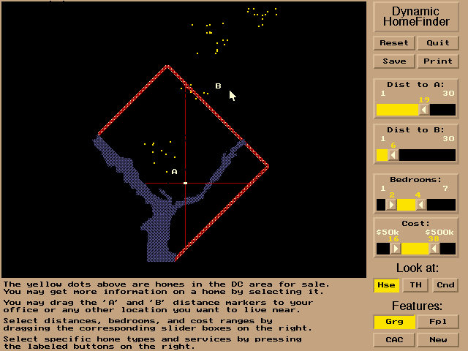
Visual Structure
Spatial substrate
Visual marks
Visual properties

Slide 24
Visual Mapping: Step 1
Map: data items → visual marks
Visual marks:
    Points
    Lines
    Areas
    Volumes
    Glyphs

Slide 25
Visual Mapping: Step 2
Map: data items → visual marks
Map: data attributes → visual properties of marks
Visual properties of marks:
    Position, x, y, z
    Size, length, area, volume
    Orientation, angle, slope
    Color, gray scale, texture
    Shape
    Animation, blink, motion

Slide 26
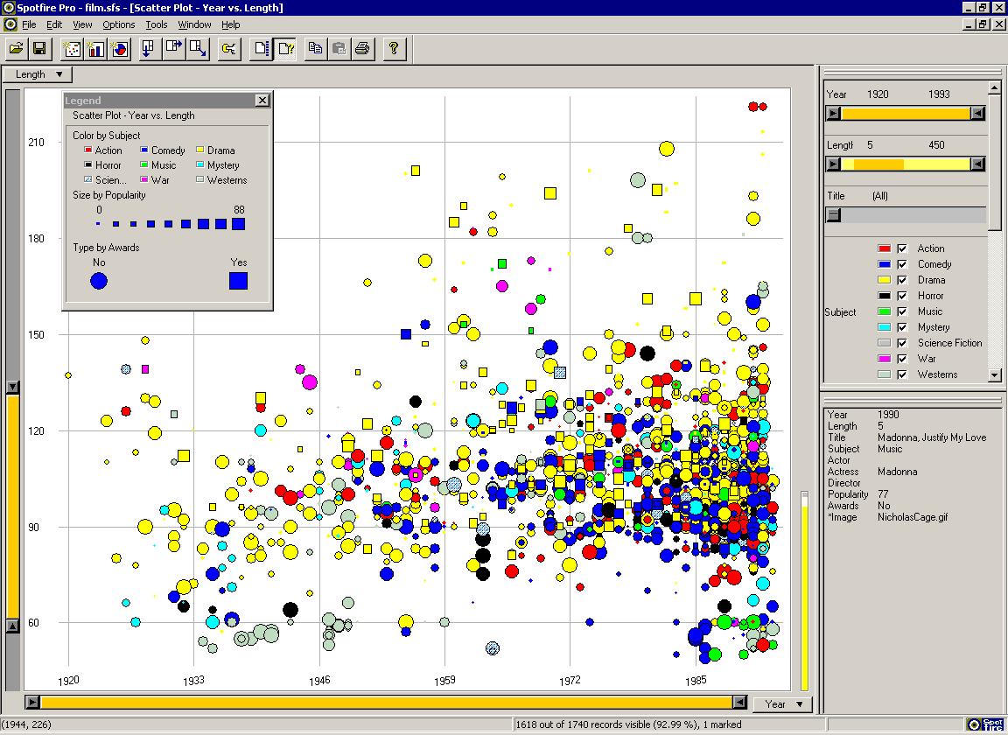
Example: Spotfire
Film database
Film -> dot
  Year → x
  Length → y
  Popularity → size
  Subject → color
  Award? → shape

Slide 27
Visual Mapping Definition Language
Films → dots
    Year → x
    Length → y
    Popularity → size
    Subject → color
    Award? → shape
Mathematically, how to map: Year → x ?

Slide 28
E.g. Linear Encoding
year → x
x – x_{min} year – year_{min}
x_{max} – x_{min} year_{max} – year_{min}
year_{min}
x_{min}
year
x
year_{max}
x_{max}
=

Slide 29
The Simple Stuff
Univariate
Bivariate
Trivariate

Slide 30
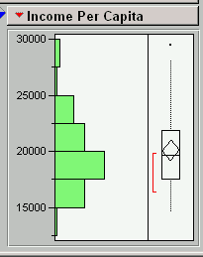
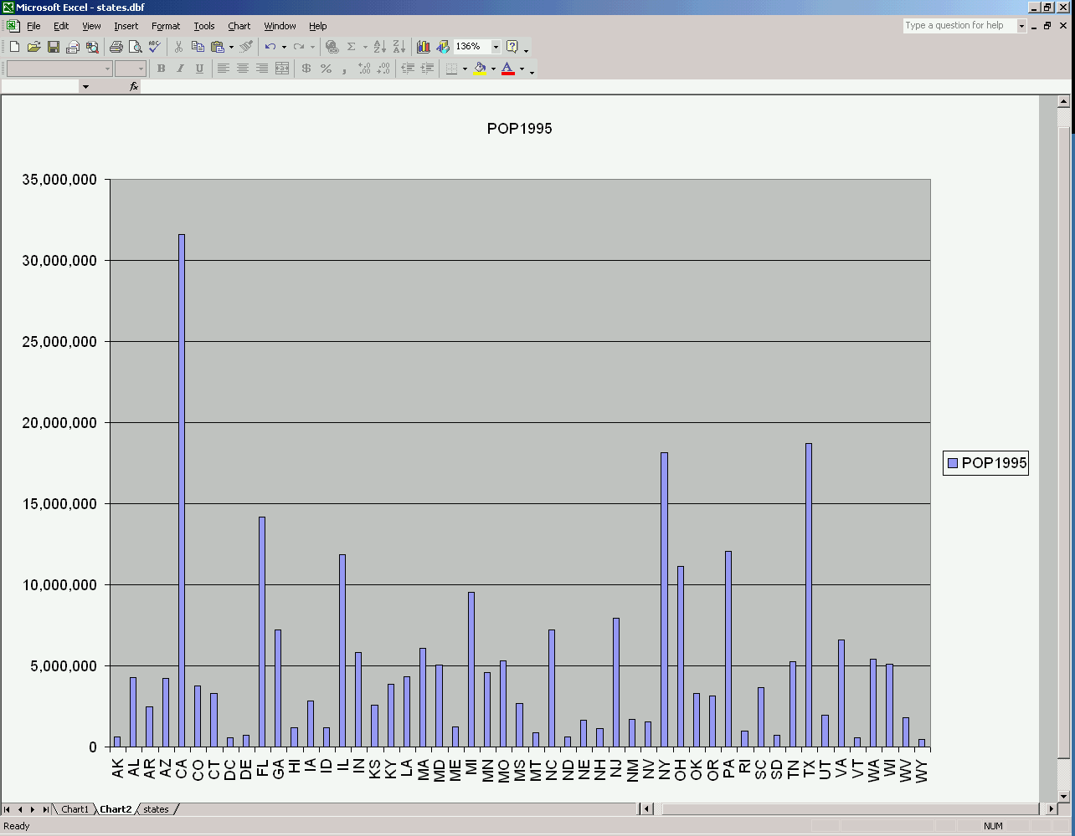
Univariate
Dot plot
Bar chart (item vs. attribute)
Tukey box plot
Histogram

Slide 31
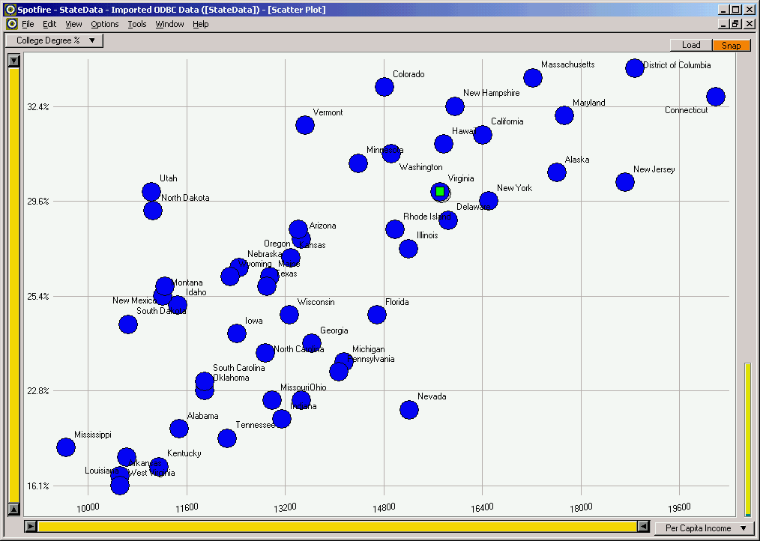
Bivariate
Scatterplot

Slide 32
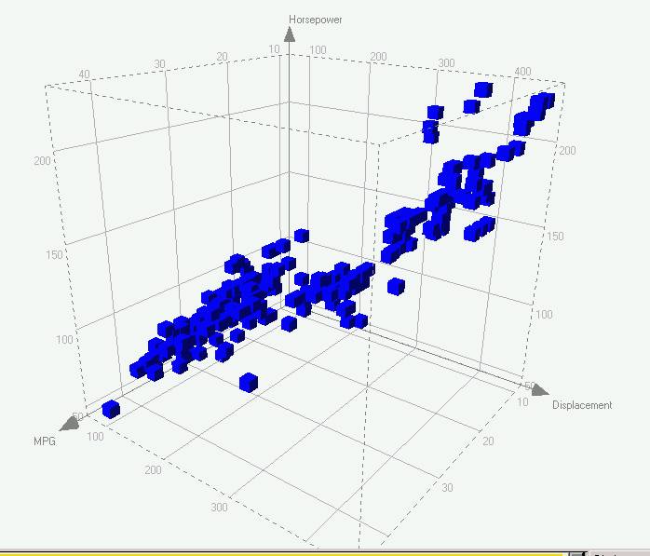
Trivariate
3D scatterplot, spin plot
2D plot + size (or color…)

Slide 33
The Challenges?

Slide 34
The Challenges?
Evaluate or compare designs?
Effectiveness?
Data transformations, whats the right data table?
More data, multidimensional
Too many dots, limited space
Choosing which data?
Semantics
System limitations
…

Slide 35
Some
Visualization Design
Principles

Slide 36
Getting Started
Start with Overview
Choose visual encodings
Consider interaction

Slide 37
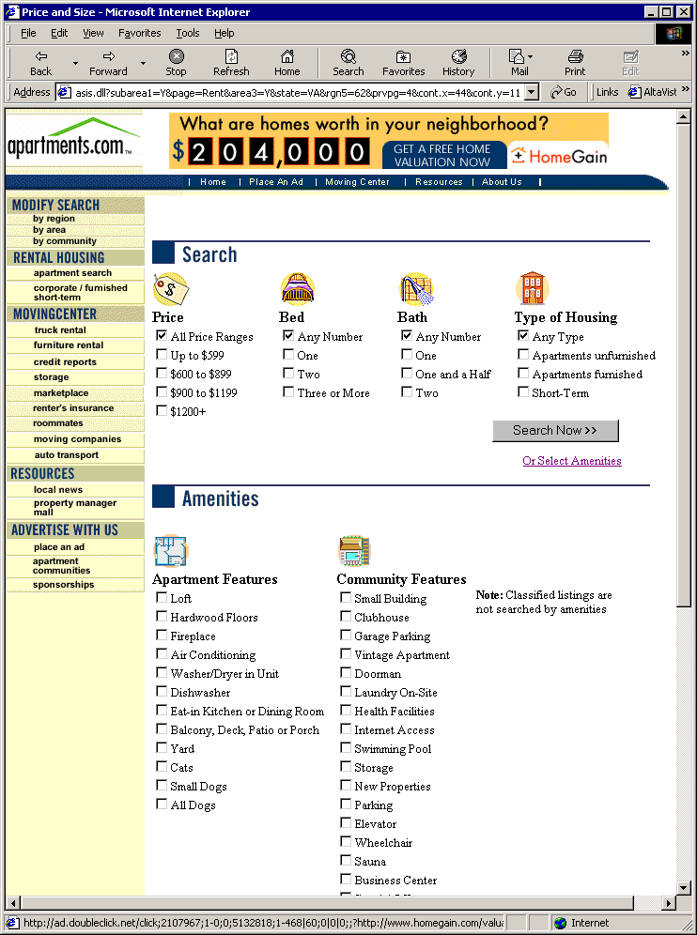
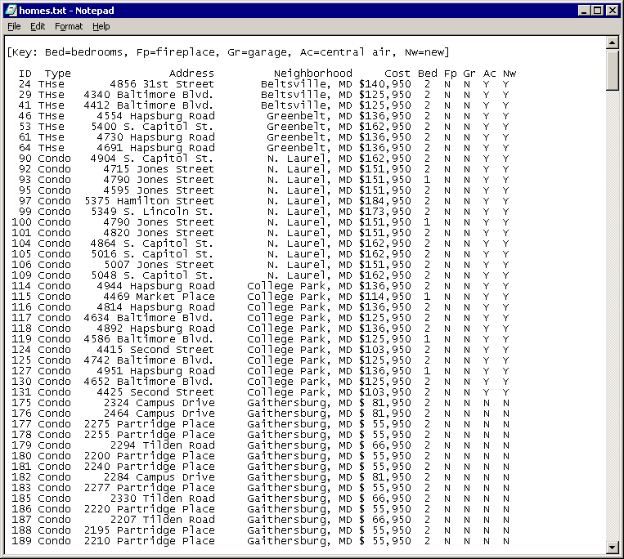
1. Start with Overview: Design for Insight
Avoid the temptation to design a form-based search engine
More tasks than just “search”
    How do I know what to “search” for?
    What if there’s something better that I don’t know to search for?
Hides the data

Slide 38
Information Visualization Mantra
(Shneiderman)
Overview first, zoom and filter, then details on demand
Overview first, zoom and filter, then details on demand
Overview first, zoom and filter, then details on demand
Overview first, zoom and filter, then details on demand
Overview first, zoom and filter, then details on demand
Overview first, zoom and filter, then details on demand
Overview first, zoom and filter, then details on demand
Overview first, zoom and filter, then details on demand
Overview first, zoom and filter, then details on demand

Slide 39
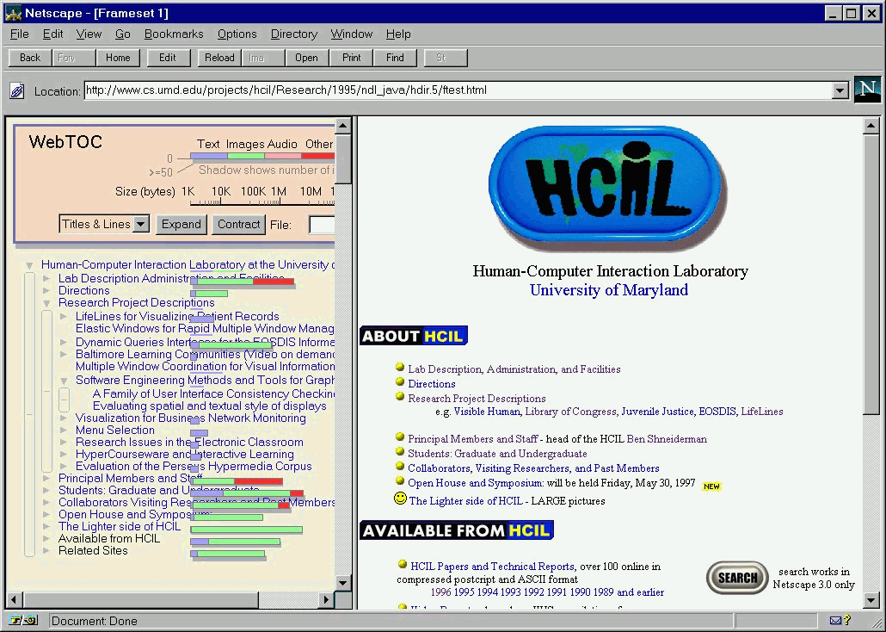
Cost of Knowledge / Info Foraging
(Card, Piroli, et al.)
Frequently accessed info should be quick
    At expense of infrequently accessed info
Bubble up “scent” of details to overview

Slide 40
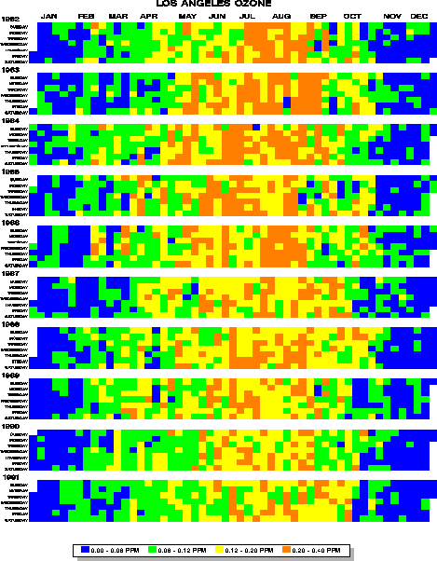
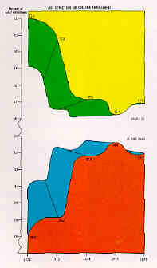
Increase Data Density
(Tufte)
Calculate data/pixel
“A pixel is a terrible thing to waste.”
(Shneiderman)

Slide 41
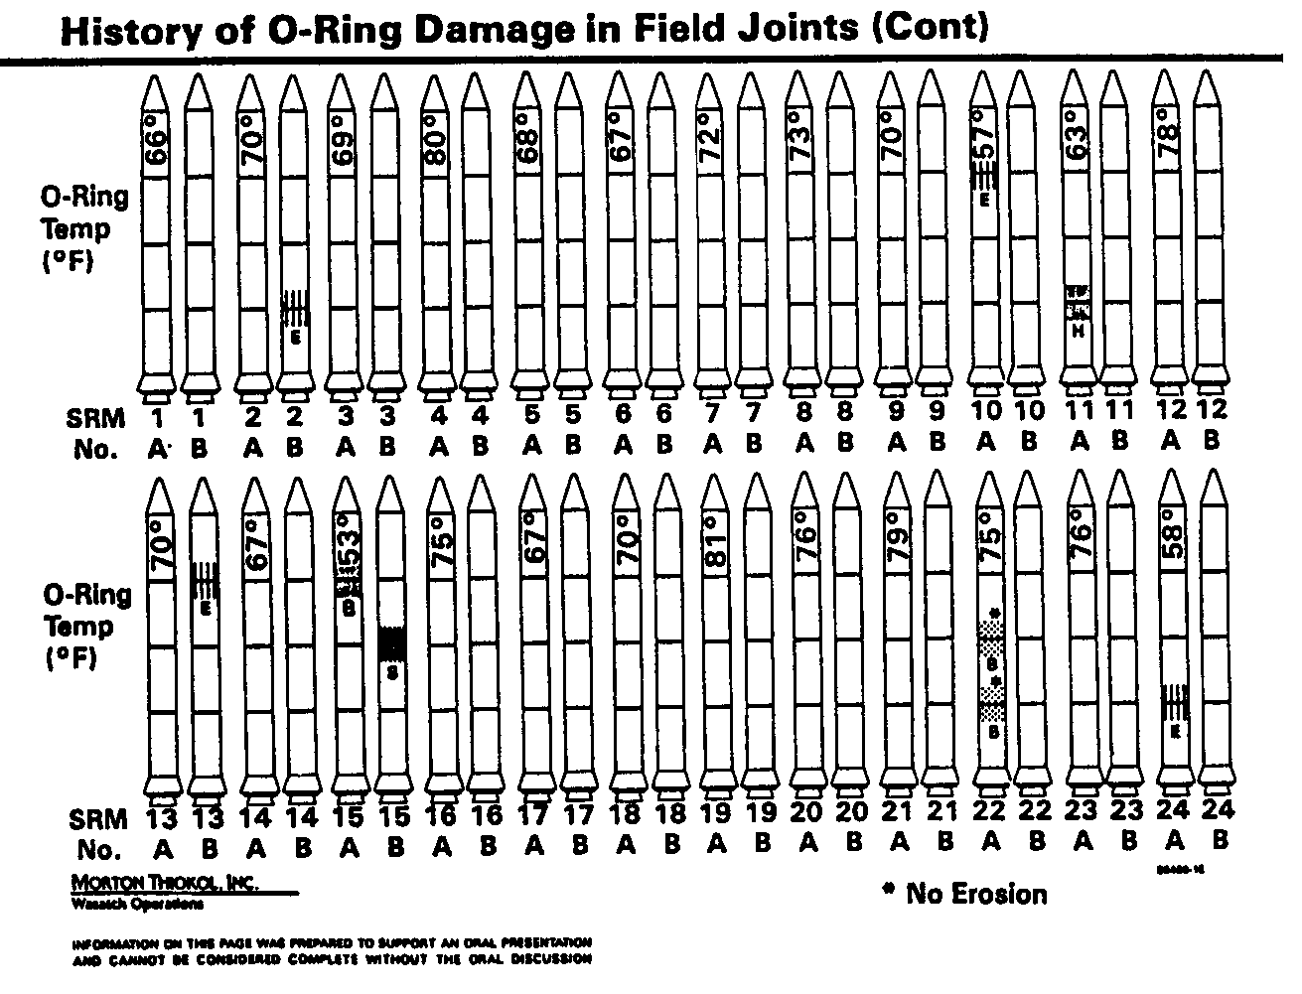
Eliminate “Chart Junk”
(Tufte)
How much “ink” is used for non-data?
Reclaim empty space
(% screen empty)
Attempt simplicity
(e.g. am I using 3d
just for coolness?)
http://academic.evergreen.edu/curricular/atpsmpa/Space%20Shuttle%20Challenger.pdf
Notes:
Good design brings absolute attention to data. Yet, instead of focusing on a possible link between damage and temperature. The vital issue here – the strongest visual presence in this graph is the clutter gernated by the outlines of the 24 shuttle rockes.

Slide 42
How would you do differently?

Slide 43
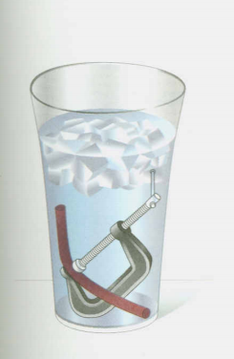
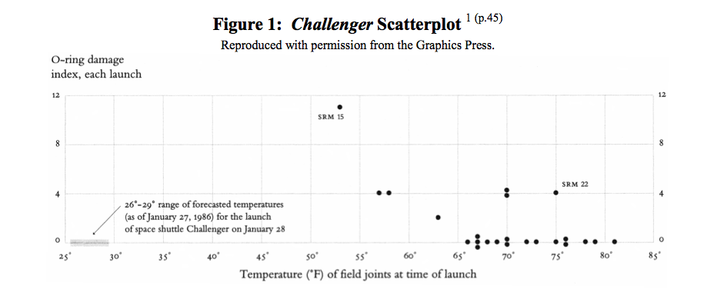
Presentation is everything
  Communication information
  Process information (a research instrument)
    Process, reason, interact, feedback
From http://people.rit.edu/wlrgsh/FINRobison.pdf

Slide 44
My Philosophy: Optimization
Computer
Serial
Symbolic
Static
Deterministic
Exact
Binary, 0/1
Computation
Programmed
Follow instructions
Amoral
Human
Parallel
Visual
Dynamic
Non-deterministic
Fuzzy
Gestalt, whole, patterns
Understanding
Free will
Creative
Moral
Visualization = the best of both
Impressive computation + impressive cognition

Slide 45
*
Design interactive visualizations
Critique existing designs and tools
Develop visualization software
Empirically evaluate designs
Understand current state-of-art
A Human-Centered Design focus
A visualization = a user interface for data

Slide 46
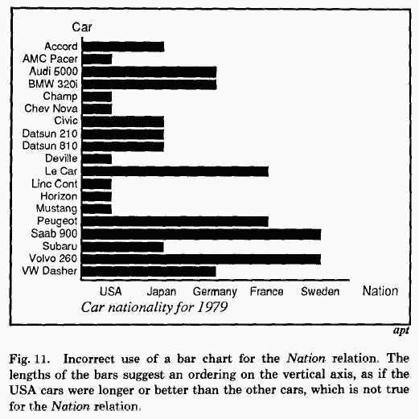
2. Choose Visual Encodings
(Mackinlay)
Expressiveness
    Encodes all data
    Encodes only the data
Effectiveness
    Cleveland’s rules

Slide 47
Ranking Visual Properties
Position
Length
Angle, Slope
Area, Volume
Color
Design guideline:
    Map more important data attributes
    to more accurate visual attributes
    (based on user task)
Increased accuracy for quantitative data
(Cleveland and McGill)
Categorical data:
Position
Color, Shape
Length
Angle, slope
Area, volume
(Mackinlay hypoth.)

Slide 48
Example
Hard drives for sale: price ($), capacity (MB), quality rating (1-5)

Slide 49
3. Consider Interaction
For un-represented data
Direct Manipulation (Shneiderman)
    Visual representation
    Rapid, incremental, reversible actions
    Pointing instead of typing
    Immediate,
    continuous feedback

Slide 50
Break out of the Box
Resistance is not futile!
Creativity; Think bigger, broader
Does the design help me explore, learn, understand?
Reveal the data

Slide 51
Class Motto

Slide 52
Class Motto
Show me the data!

Slide 53
Visualization Design

Slide 54
HCI Design Process
1. Analyze
2. Design
3. Evaluate
Iterative, progressively concrete

Slide 55
HCI UI Evaluation Metrics
User learnability:
    Learning time
    Retention time
User performance: ***
    Performance time
    Success rates
    Error rates, recovery
    Clicks, actions
User satisfaction:
    Surveys
Not “user friendly”
Measure while users perform benchmark tasks

Slide 56
Visualization Design
Analyze problem:
    Data: schema, structures, scalability
    Tasks/insights
    Prioritize tasks and data attributes
Design solutions:
    Data transformations
    Mappings: data→visual
    Overview strategies
    Navigation strategies
    Interaction techniques
    multiple views vs. integrated views
Evaluate solutions:
    Analytic: Claims analysis, tradeoffs
    Empirical: Usability studies, controlled experiments

Slide 57
1. Analyze the Problem
Data:
    Information structure
    Scalability***
Users:
    Tasks
Existing solutions (literature review)

Slide 58
Information Structures
Tabular: (multi-dimensional)
Spatial & Temporal:
    1D:
    2D:
    3D:
Networks:
    Trees:
    Graphs:
Text & Documents:

Slide 59
Data Scalability

Slide 60
Data Scalability
# of attributes (dimensionality)
# of items
Value range
(e.g. bits/value)

Slide 61
User Tasks
Easy stuff:
    Reduce to only 1 data item or value
    Stats: Min, max, average, %
    Search: known item
Hard stuff:
    Require seeing the whole
    Patterns: distributions, trends, frequencies, structures
    Outliers: exceptions
    Relationships: correlations, multi-way interactions
    Tradeoffs: combined min/max
    Comparisons: choices (1:1), context (1:M), sets (M:M)
    Clusters: groups, similarities
    Anomalies: data errors
    Paths: distances, ancestors, decompositions, …
Forms can do this
Visualization can do this!

Slide 62
2. Design
Methods:
    Identify existing solutions (literature review)
    Task centric: Optimize tasks on data
    Scenario-based
    Apply principles
    Morphology
Artifacts:
    Paper sketches
    Mockups (powerpoint, macromedia,…)
    Prototypes (VB, …)
    Implementation

Slide 63
3. Evaluate
Claims Analysis:
Identify an important design feature
    + positive effects of that feature
    - negative effects of that feature
Identify a design dimension
    Identify designs alternatives
    +/- tradeoff effects
Tradeoff Analysis:

Slide 64
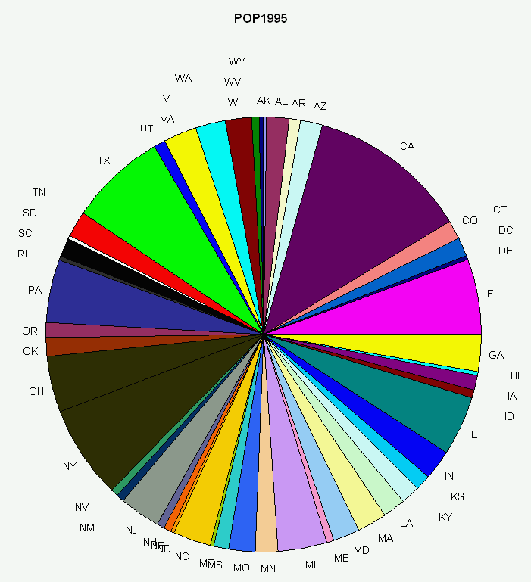
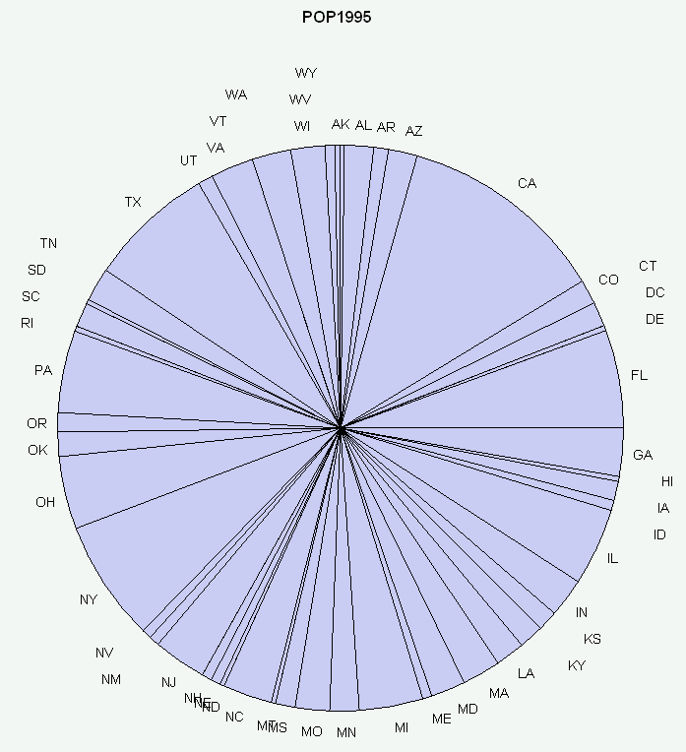
Exercise: Pie vs. Bar
Data: population stats
Scalability? Effectiveness for Tasks?

Slide 65
Pie vs. Bar
Scalability: state and pop overloaded on circumf.
- use angle
- relative
+ faster to detect the max
Sensitive to screen space – easier to see difference when screen size is large
+ change the circumf = f(size)
- range problem.
state on x, pop on y
+ use length instead of angle
+ absolute
+ more distinct
- range problem

Slide 66
Stacked Bar
AK
AL
AR
CA
CO
…

Slide 67
How (not) to Lie with Visualization

Slide 68
Upcoming
Tabular (multi-dimensional)
Spatial & Temporal
    1D / 2D
    3D
Networks
    Trees
    Graphs
Text & Docs
Overview strategies
Navigation strategies
Interaction techniques
Development
Evaluation

Slide 69
Project
Creativity
Open ended
Often no “right” answer
Reasoning/argument is more important
Thinking deeply
Self motivation, seek to excel
Contribute to the state-of-the-art
Jump start for thesis research, publication

Slide 70
Project
Groups of 2-3 students, no more than 4.
Visualization for Data Analysis
Milestones:
    Team: choose team (due very soon… )
    Design Concept & Presentation: problem, lit. review, design, schedule
    Initial implementation
    Complete implementation
    Evaluation
    Final presentation
    Final paper: publishable?

Slide 71
Paper Presentations
We are still deciding how to run the paper reading mill due to the high enrollment. Here is what we have planned to do but may change this as we know the exact number of students and the number of topics to be covered.
  Each student gets 1-2 slots during semester
  Choose a paper from a set I will distribute tonight.
  Present the paper in class
    15 minutes: Show the demo/pictures/video | Convey 1-2 main ideas | How does it really help | Make a scientific argument | Discuss

Slide 72
Implementation detail crap
The first step of processing requires the construction of several tree and graph structures to store the database.
System then builds visualization of data by mapping data attributes of graph items to graphical attributes of nodes and links in the visualization windows on screen.
More boring stuff nobody is ever going to read here or if they do they wont understand it anyway so why bother.
If they do read it then they most certainly will not be listening to what you are saying so why bother give a talk? Why not just sit down and let everybody read your slides or just hand out the paper and then say ‘thank you’.
This person needs to take Jian’s vis class.

